Slide 1
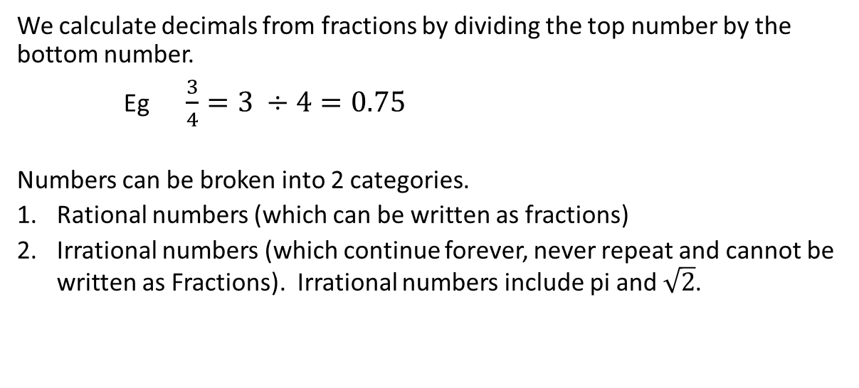
24
7
30
Topic: Types of Decimals
Date
EQ – What are the different types of decimal numbers?
We calculate decimals from fractions by dividing the top number by the bottom number.
Eg $\frac{3}{4}=3 ÷4=0.75$
Numbers can be broken into 2 categories.
Rational numbers (which can be written as fractions)
Irrational numbers (which continue forever, never repeat and cannot be written as Fractions). Irrational numbers include pi and $\sqrt{2}$.
Rational number can be 2 types.
Recurring decimals - which have a repeating pattern that continues forever.
eg 1 ÷ 3 = 0.333333333…..
2 ÷ 7 = 0.285714285714285714…
Terminating decimals – which stop
eg 0.75, 0.4, 0.125

Slide 2
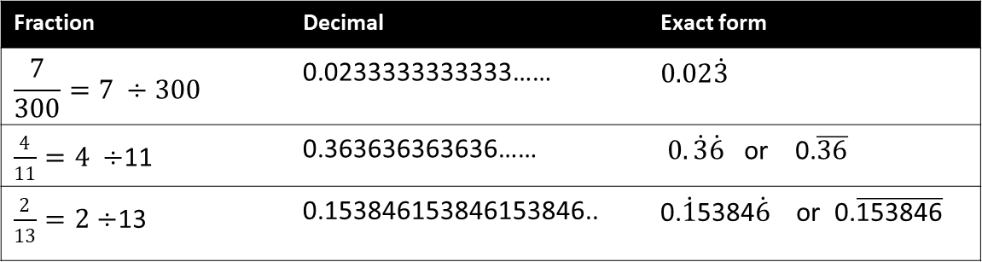
24
7
30
Topic: Types of Decimals
Date
EQ – What are the different types of decimal numbers?
How do we write recurring decimals?
Write any non-recurring digits, then the digits that form the repeating pattern
Place a dot on top of the first and last digits of the repeating pattern, or draw a line above them
This is called writing the decimal in EXACT FORM
Fraction | Decimal | Exact form
$$\frac{7}{300}=7 ÷300$$ | 0.0233333333333…… | $$0.02\dot{3}$$
$\frac{4}{11}=4 ÷$11 | 0.363636363636…… | $0.\dot{3}\dot{6}$ or 0.$\overline{36}$
$\frac{2}{13}=2÷$13 | 0.153846153846153846.. | 0.$\dot{1}$5384$\dot{6}$ or 0.$\overline{\text{153846}}$

Slide 3
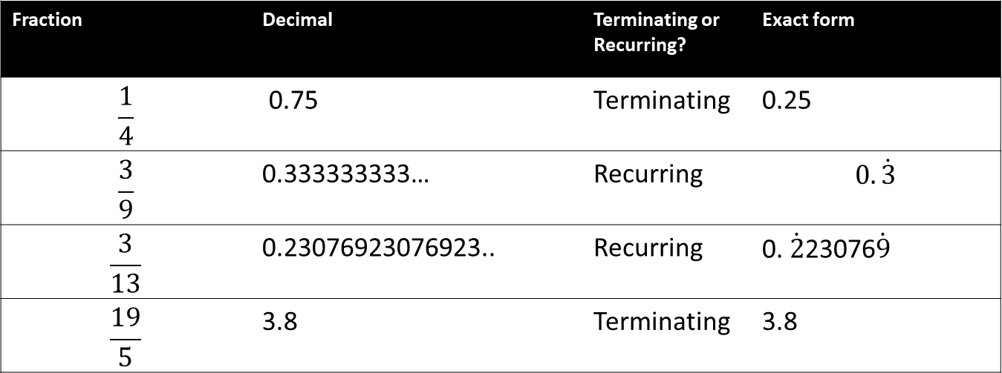
We try
Fraction | Decimal | Terminating or Recurring? | Exact form
$$\frac{1}{4}$$ | 0.75 | Terminating | 0.25
$$\frac{3}{9}$$ | 0.333333333… | Recurring | $$0.\dot{3}$$
$$\frac{3}{13}$$ | 0.23076923076923.. | Recurring | 0. $\dot{2}$23076$\dot{9}$
$$\frac{19}{5}$$ | 3.8 | Terminating | 3.8

